Slide 1
BDD in Blazor

Slide 2







Un grazie agli sponsor

Slide 3







E alle community che ci hanno supportato

Slide 4



Scenario

Slide 5

I’m a backend developer !?!?!

Slide 6
Maybe …
The lowest level of knowledge is when we make a lot of decisions about the future system
It’s easy to make things complicated, but it’s complicated to make them simple

Slide 7
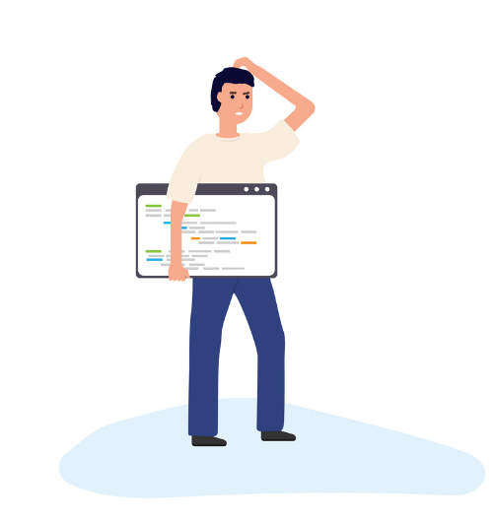
What’s the risk?
Risk comes from not knowing what you are doing
(Warren Buffet)
The only way to decrease ignorance is to increase understanding

Slide 8

Learn, learn, learn

Slide 9
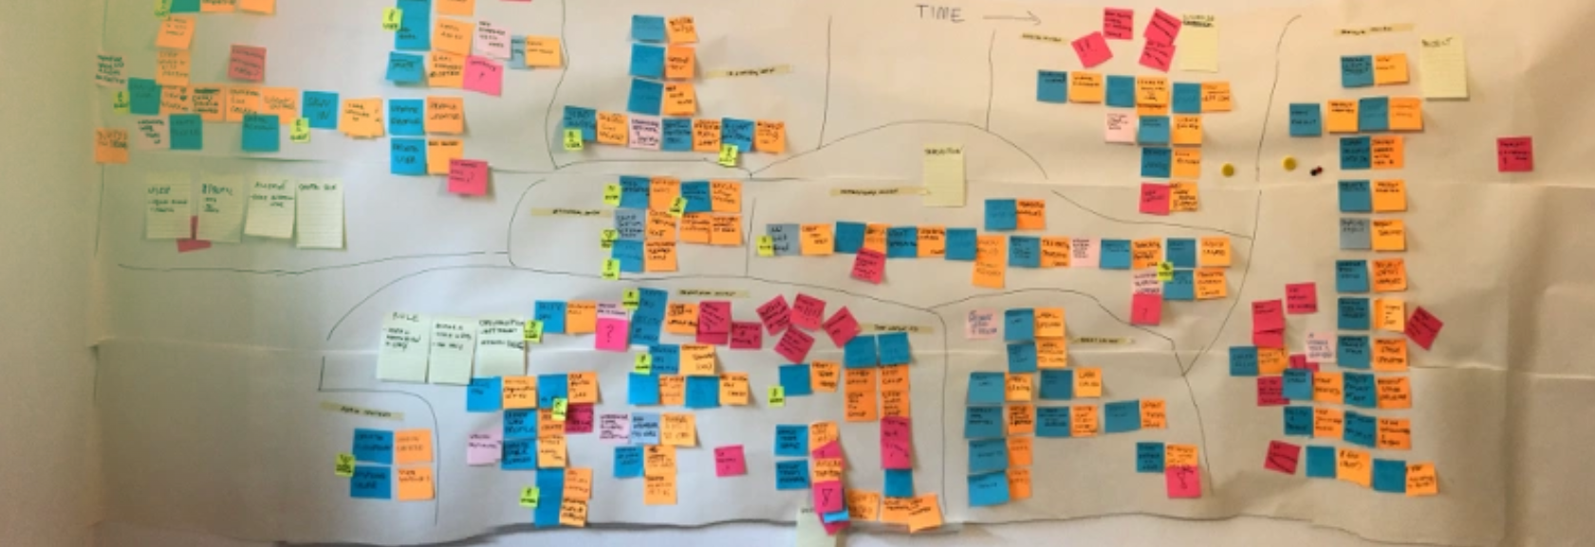
EventStorming

Slide 10
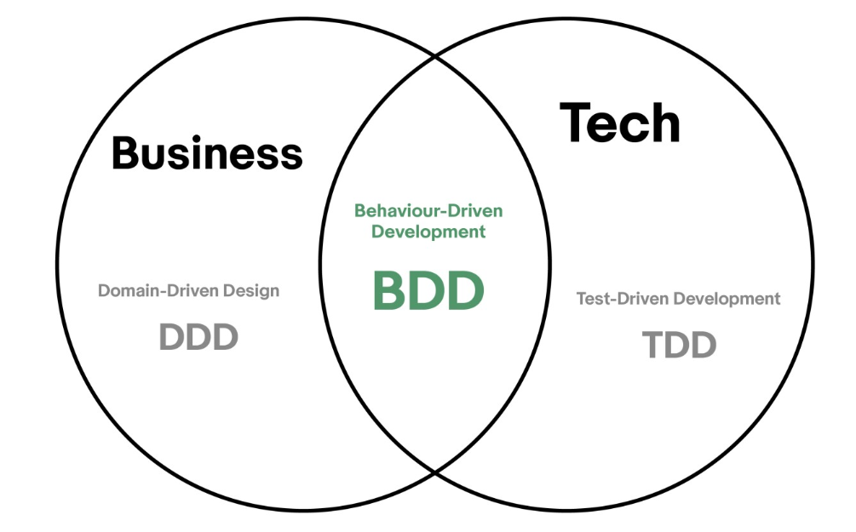
From test, of course

Slide 11
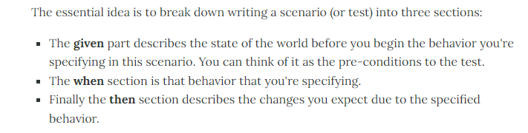
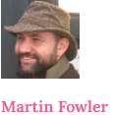
What?

Slide 12

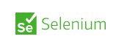

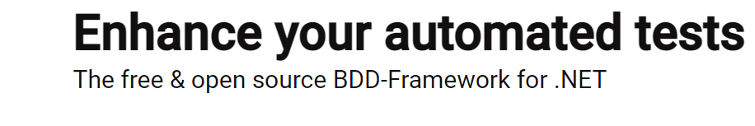
What we need?

Slide 13
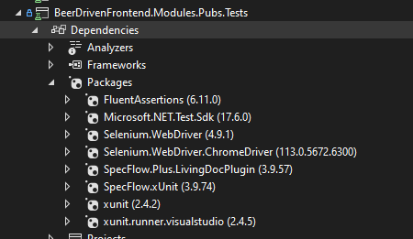
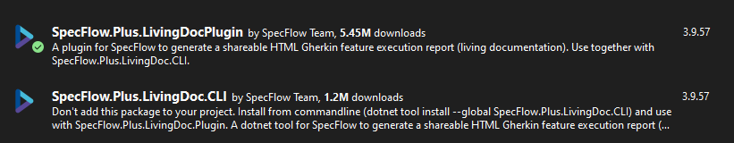
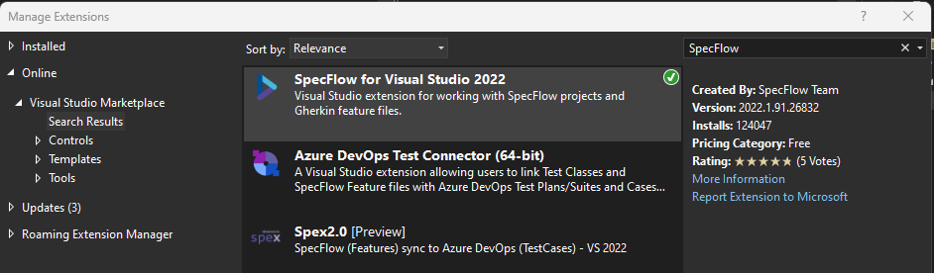
Environment configuration

Slide 14
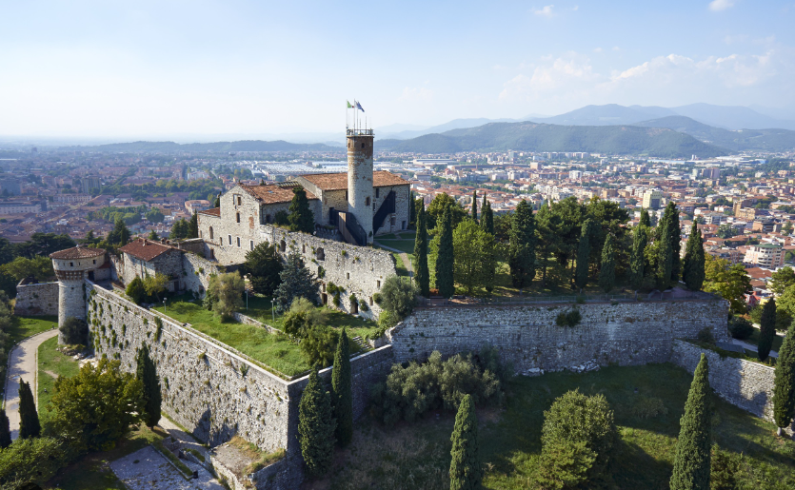
Demo
KEEP CALM
and
POTA

Slide 15
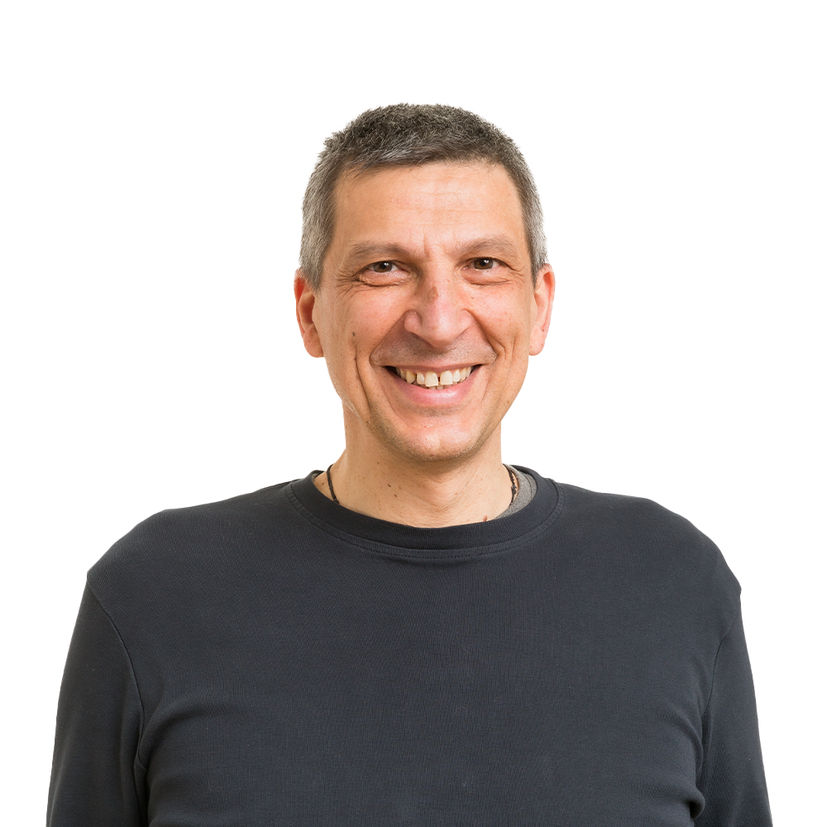







About Me
alberto.acerbis@intre.it
https://github.com/brewup
https://github.com/cqrs-muflone
https://github.com/ace68
https://www.twitch.tv/dddbrewup

